Slide 1
A Chrome Extension that converts image with text
Presentation by : VINIT Mehra (ra1911026010065)
Seminar project

Slide 2
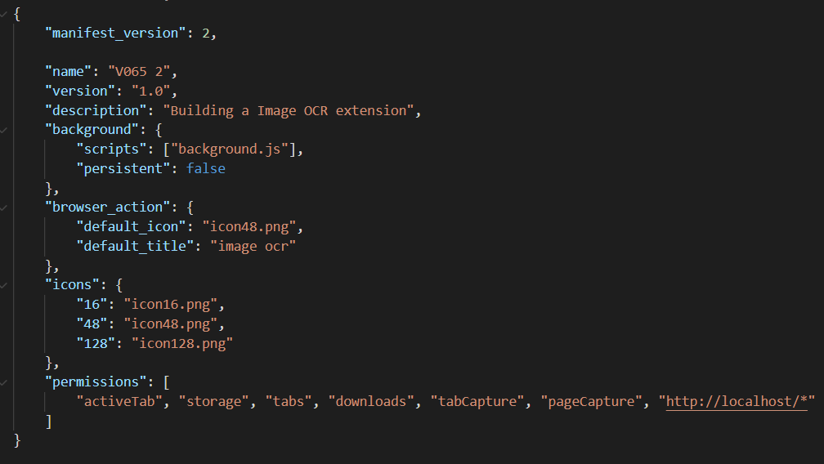
Module Implementation
Manifest file
The core of a chrome extension is the manifest file. We need to create a manifest.json file in our folder. This is the identity file of a chrome extension.
Here we give the name, icon, version and description of our chrome extension along with connecting with it’s background script and giving permission for our extension.

Slide 3

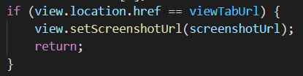

Taking Screenshot
First, we add a listener on our icon placed on the right of the address bar and capture the visible tab using the chrome tabs API and call captureVisibleTab method. This method returns us the data URL which we will use to set image to html image tag and show the image in the next tab.

Slide 4
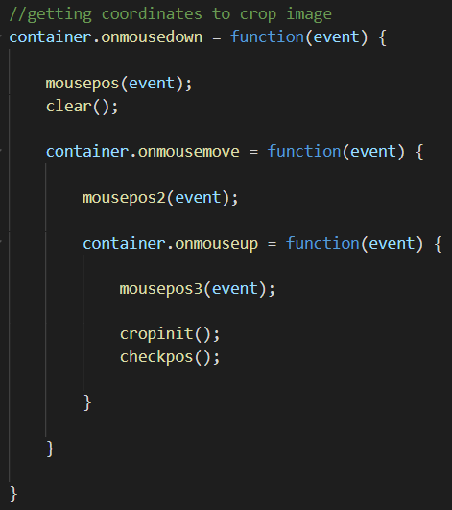
Cropping
After getting screenshot we will crop the image using html canvas.
First we will take the co-ordinates of cropping area in the container via calling onmousedown event and onmouseup event inside the container.

Slide 5
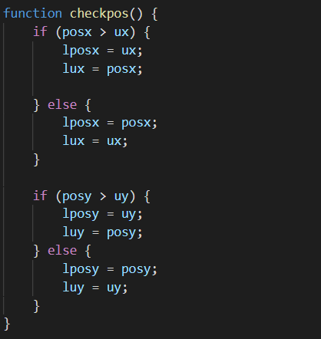
Cropping
After getting co-ordinates we check their position to get top left co-ordinate (starting position for canvas) of crop area.
Such that the smaller co-ordinate out of respective x and y positions gets to be starting position of canvas.

Slide 6
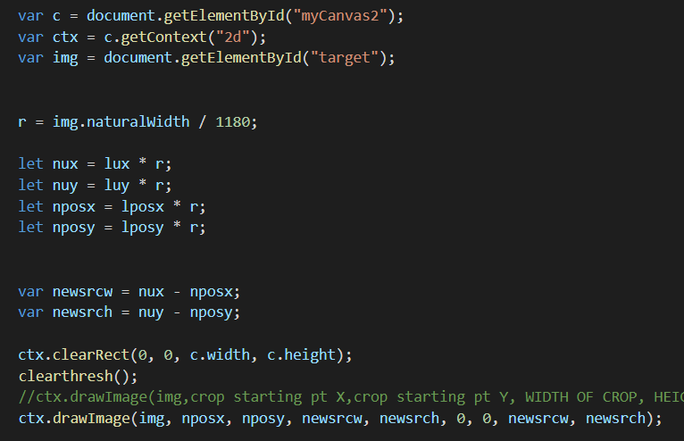
Cropping
Finally draw the image in html canvas via passing in the following syntax:
ctx.drawImage(image,
crop starting pt X, crop starting pt Y,
WIDTH OF CROP, HEIGHT OF CROP,
plotting x position, y position,
plotted width, plotted height)

Slide 7
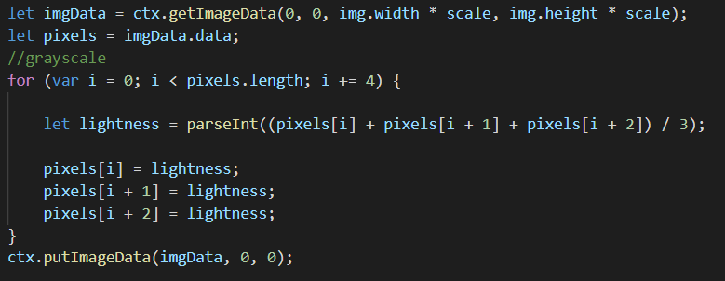
Grayscale
Extracting image pixels and converting them to their respective grayscale value before passing them for threshold.
An RGB Image consists of 3 layers R,G,B as it is clearly see through its name. It’s a 3 dimensional matrix, where grayscale image is of only 2 dimensions, and the values ranges between 0–255 (8-bit unsigned integers).

Slide 8
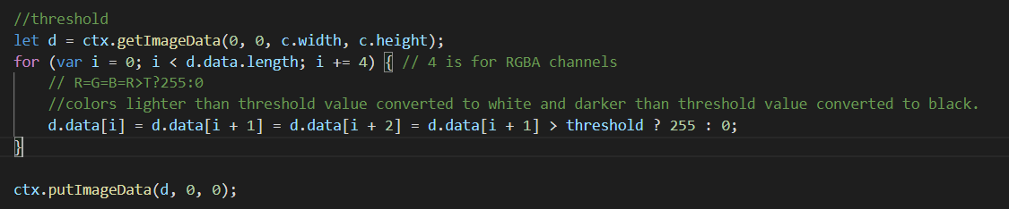
Threshold
After getting grayscale apply threshold to image such that colors lighter than threshold value converted to white and darker than threshold value converted to black.

Slide 9
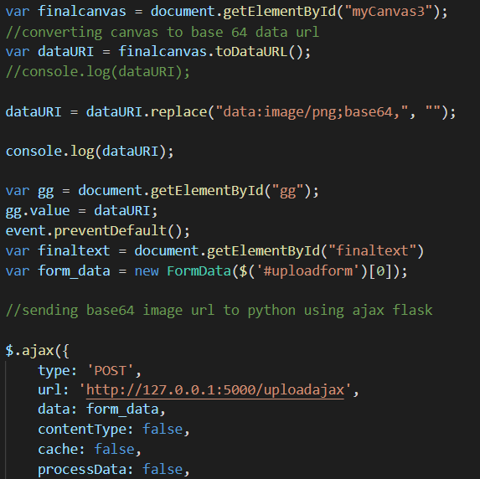
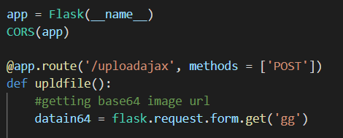
pytesseract
Using ajax and flask we connect our java script of our chrome extension to python.
First we convert our canvas image to base64 image data url and pass it to python flask via ajax in type of form.

Slide 10
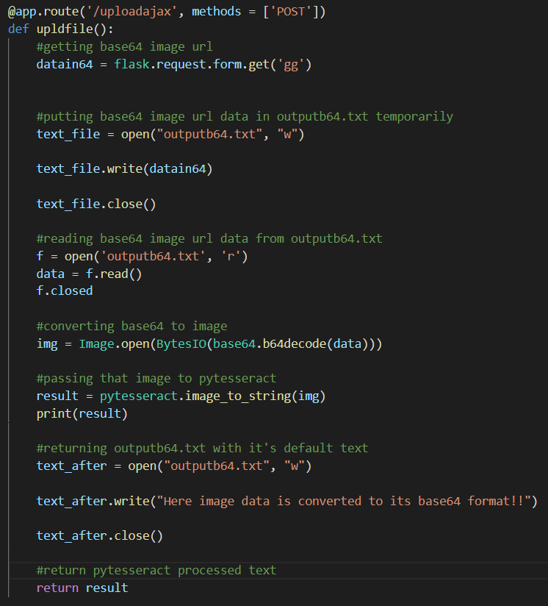
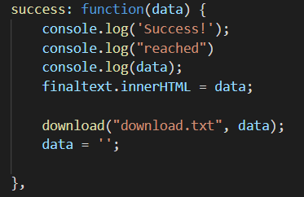
pytesseract
After getting the image in base64 data url format we convert into image format and then pass it through pytesseract and return the processed text into our javascript and then download the text as download.txt.

Slide 11
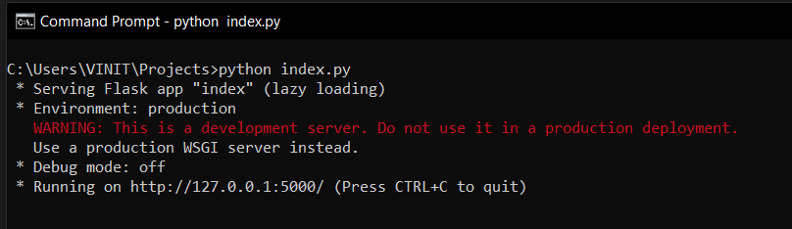
DEMO:
(!!!Before using the final convert button python flask file is needed to be running in background via local server http://127.0.0.1:5000/ else python flask will not run and pytesseract will not convert image to text)

Slide 12
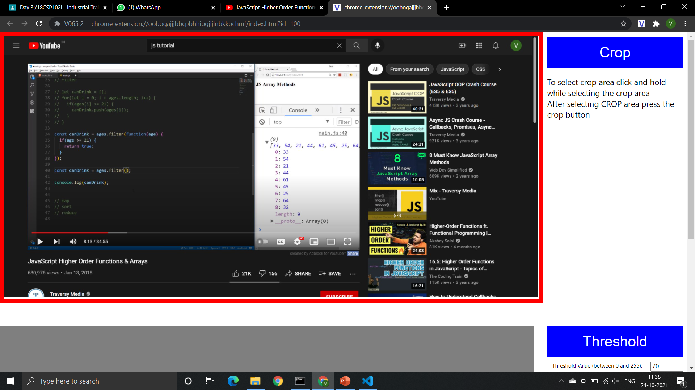

DEMO:
How to use:
Step1: Go to desired website and click on the extension logo.
It will result in taking the screenshot of current tab where you are and open it in a new tab.

Slide 13
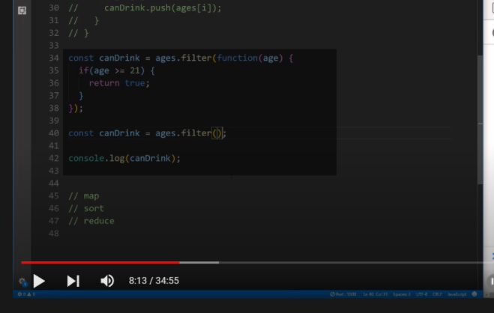
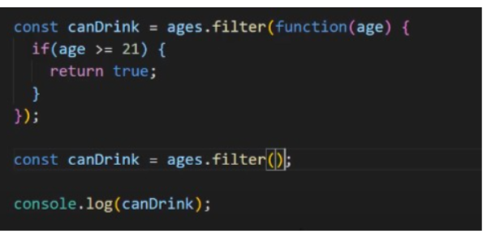
DEMO:
Step2: Selecting the crop area and then pressing the crop button it will replace the temporary image with your cropped image. The darker area shown in the image is your selected crop area.

Slide 14
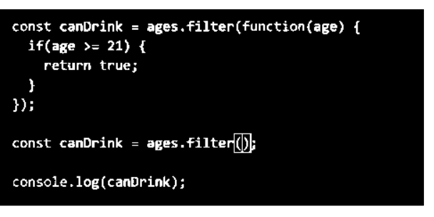
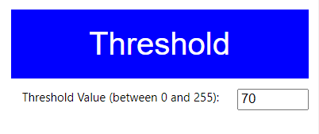
DEMO:
Step3: Select the suitable threshold value by inputting manually. To check the preview press threshold button.
(Here the image is converted to grayscale before thresholding)

Slide 15
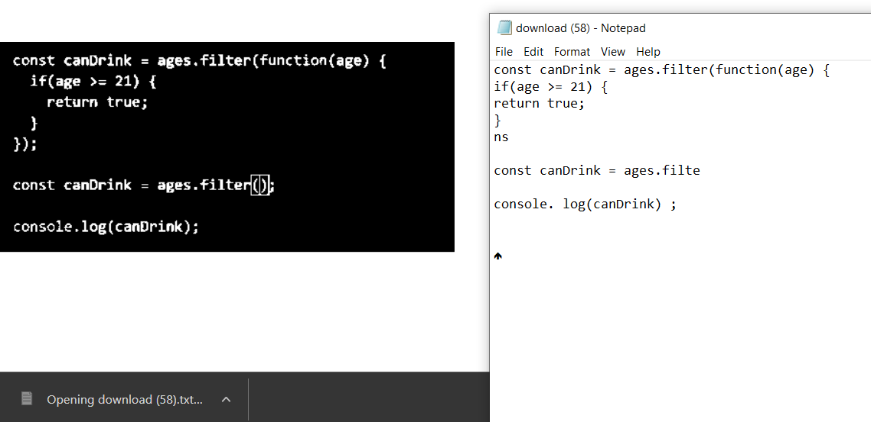
DEMO:
Step4: Press the convert button to get text from image in download.txt file.
(!!!Make sure python flask file is running in local server in background)

Slide 16
THANK YOU!

